Slide 1
AI BASED NATURAL DISASTER INTENSITY ANALYSIS USING IBM WATSON
TEAM MEMBERS:
G.SHEBHA RANI(19R11A05G2)
GOPAGONI HARIKA(19R11A05G3)
GUNdETI SANNIHITHA(19R11A05G6)
KATUKAM AKHILA(19R11A05H4)
K.NIHARIKA(19R11A05H6)

Slide 2
INTRODUCTION:
Natural disasters not only disturb the human ecological system but also destroy the properties and critical infrastructures of human societies and even lead to permanent change in the ecosystem. Disaster can be caused by naturally occurring events such as earthquakes, cyclones, floods, and wildfires. Many deep learning techniques have been applied by various researchers to detect and classify natural disasters to overcome losses in ecosystems, but detection of natural disasters still faces issues due to the complex and imbalanced structures of images. To tackle this problem, we developed a multilayered deep convolutional neural network model that classifies the natural disaster and tells the intensity of disaster .The model uses an integrated webcam to capture the video frame and the video frame is compared with the Pre-trained model and the type of disaster is identified and showcased on the OpenCV window.

Slide 3
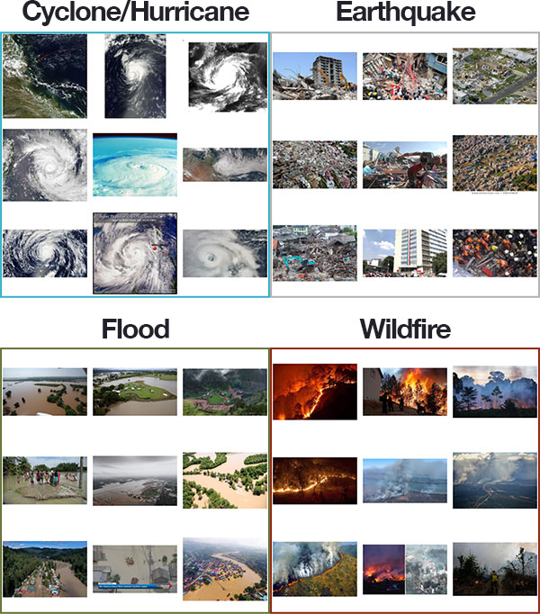

Slide 4
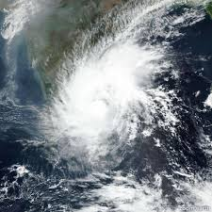
AI Could Help Predict Natural Disasters, Here is How
Satellite Imagery
AI-based systems can scan images obtained from satellites orbiting the earth, and look for any changes that could help to predict the occurrence of a natural disaster like landslides, floods, volcanic eruptions, and tsunamis.

Slide 5
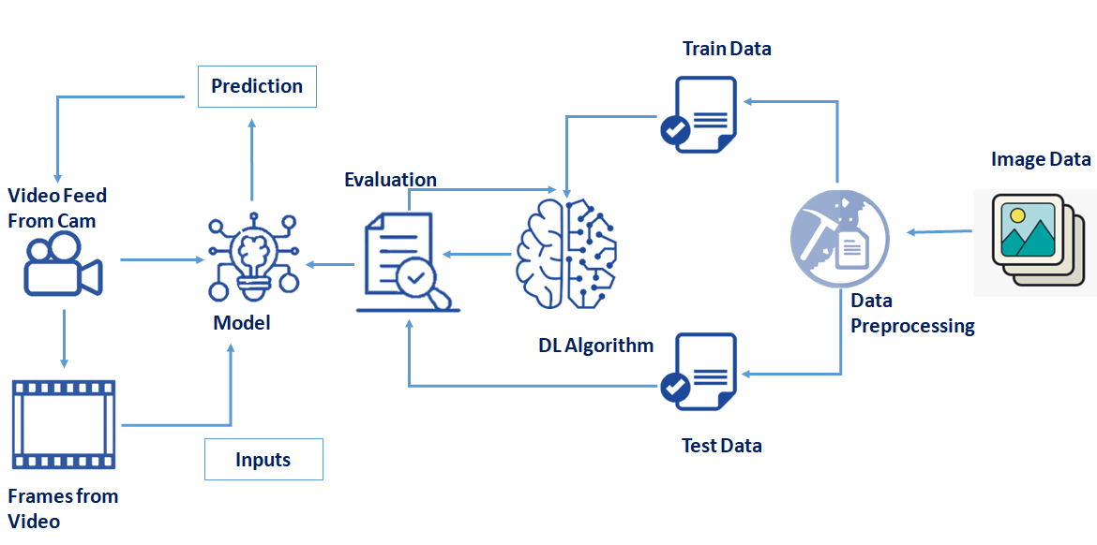
Technical Architecture:

Slide 6
Project Objectives:
know fundamental concepts and techniques of the Artificial Neural Network and Convolution Neural Networks
Gain a broad understanding of image data.
Work with Sequential type of modeling
Work with Keras capabilities
Work with image processing techniques
Work with Opencv

Slide 7
Project Flow
The user interacts with the UI (User Interface) to open the integrated webcam.
The video frames are captured and analyzed by the model which is integrated with flask application.
Once model analyses the video frames, the prediction is showcased on the UI and OpenCV window
To accomplish this, we have to complete all the activities and tasks listed below
Data Collection.
Collect the dataset or Create the dataset
Data Preprocessing.
Import the ImageDataGenerator library
Configure ImageDataGenerator class
Apply ImageDataGenerator functionality to Trainset and Testset
Model Building
Import the model building Libraries

Slide 8
So let’s get into the project……….

